Slide 1
SEEDING AFRICA | DATA ANALYSIS TRACK
INFLATION, PURCHASING POWER AND SAVINGS BEHAVIOUR OF NIGERIAN SALARY EARNERS
Evidence from a Survey of Nigerian Salary Earners with 3+ Years of Work Experience
OLATUNJI HALIMOH TEMIDAYO
FemTech Information Technology Institute | May 2026

Slide 2
SEEDING AFRICA | DATA ANALYSIS TRACK
INFLATION, PURCHASING POWER AND SAVINGS BEHAVIOUR OF NIGERIAN SALARY EARNERS
Evidence from a Survey of Nigerian Salary Earners with 3+ Years of Work Experience
# #
OLATUNJI HALIMOH TEMIDAYO
FemTech Information Technology Institute | May 2026
How has inflation affected the purchasing power and savings behaviour of Nigerian salary earners?

Slide 3
OVERVIEW
Presentation Outline
01
Introduction, Aim and Background
The problem, aim, objectives and research questions
02
Methodology and Data Sources
Questionnaire design, study population, data collection and analytical workflow
03
Key Findings from Excel and SQL
Major insights on inflation, purchasing power and savings behaviour
04
Python Statistical Analysis
Correlation analysis, outlier detection and key statistical findings
05
Power BI Dashboard
Interactive visualizations across 6 dashboard pages
06
Key Findings
Core discoveries from the analysis
07
Limitations
Data constraints and study boundaries
08
Summary
What the data revealed
09
Conclusion
Final interpretation of the research findings
10
Recommendations
Evidence-based recommendations for individuals, employers and policymakers
2

Slide 4
01 INTRODUCTION
Background, Problem Statement and Aim
BACKGROUND
PROBLEM STATEMENT
Nigeria is experiencing one of its most severe inflation surges in decades, driven by fuel subsidy removal, currency devaluation, and rising food prices
Salary earners; civil servants, teachers, nurses, and private sector workers, earn fixed incomes that cannot automatically adjust to rising prices
A salary earner earning ₦100,000 in 2020 and still earning the same today has lost more than half of their real purchasing power
The pain of inflation is not equal, a junior civil servant below ₦80,000 faces a fundamentally different financial reality than a manager above ₦500,000
Nigerian salary earners are caught in a financial trap. Their nominal salaries have remained largely stagnant while the cost of living continues to surge, silently eroding their real purchasing power, depleting their savings, and pushing many into debt cycles just to survive monthly. Despite the severity of this crisis, the specific income levels at which salary earners tip from managing to barely surviving, and which financial coping strategies are genuinely effective versus which ones are making things worse, remain unmeasured and poorly understood at the individual level in Nigeria.
AIM OF THE STUDY
To collect primary data from Nigerian salary earners and analyse the effect of inflation on their purchasing power and savings behaviour across different income levels, employment sectors, and demographic groups, and deliver practical, evidence-based recommendations for government, employers, financial institutions, and individuals.
3

Slide 5
01 INTRODUCTION
Project Objectives
Five research objectives guiding the analysis of inflation, purchasing power, and savings behaviour among Nigerian salary earners.
01
02
03
Assess Purchasing Power
Analyze Expenditure Impact
Examine Savings Behaviour
Determine the current purchasing power of Nigerian salary earners and determine how inflation has affected their ability to meet basic financial needs.
Identify the expenditure categories most affected by inflation and determine which essentials consume the largest share of monthly income.
Assess how inflation has reduced savings capacity and influenced long-term financial planning among Nigerian salary earners.
04
05
Compare Demographic Impact
Evaluate Coping Strategies
Determine whether the effects of inflation differ across income levels, gender, age groups, and employment sectors.
Examine the financial coping strategies adopted by Nigerian salary earners and recommend practical approaches to protect purchasing power and rebuild savings.
4

Slide 6
02 METHODOLOGY
Data Collection and Integrated Methodology
Structured Questionnaire
Target Population
Research Variables
Primary Dataset Source
Study Participants
Variables Analysed
501 valid responses collected
Nigerian salary earners
Minimum of 3 years of work experience
Structured questionnaire survey
Nigerian salary earners
Public and private sectors
Self-employed and NGO/International organisations
Respondents across different income groups
Purchasing Power
Income Expenditure
Savings Behaviour
Financial Coping Strategies
Demographic Characteristics
ANALYTICAL WORKFLOW
Excel
SQL
Python
Power BI
Data entry, Data cleaning
EDA and Data validation
Structured queries
10 analytical queries
Correlation analysis
Outlier detection
Interactive dashboard
6 pages
5

Slide 7
03 FINDINGS
Dataset Overview and Descriptive Statistics
501
49.7%
3+
3.8
out of 5
Total Respondents
Purchasing Power Decline Rate
Work Experience Required
Highest Expenditure Impact Score
PURCHASING POWER & SAVINGS STATISTICS
EXPENDITURE CATEGORY AND DEBT STATISTICS
Purchasing Power Decline Rate: 49.7%
Stopped Saving or Reduced Savings: 57.28%
Completely Stopped Saving Rate: 27.10%
Completely Depleted Savings: 39.32%
Only 20.16% are genuinely financially stable
Most Affected Category: Food & Groceries (3.8 out of 5)
Transportation & Fuel Impact Score: 3.4 out of 5
Healthcare Impact Score: 3.1 out of 5
Debt Rate: 40.5%
Spending More Than 70% on Essentials: 70.86%
6

Slide 8
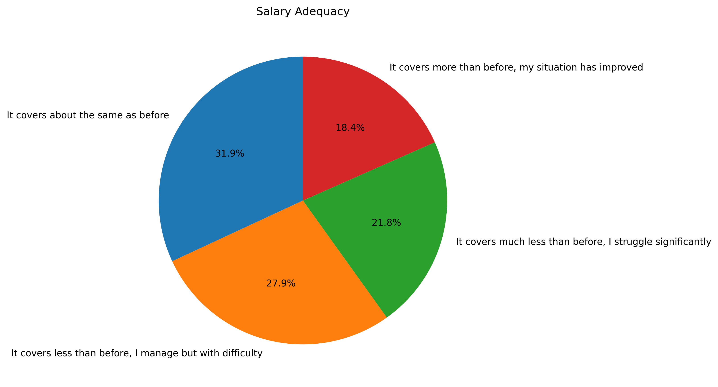
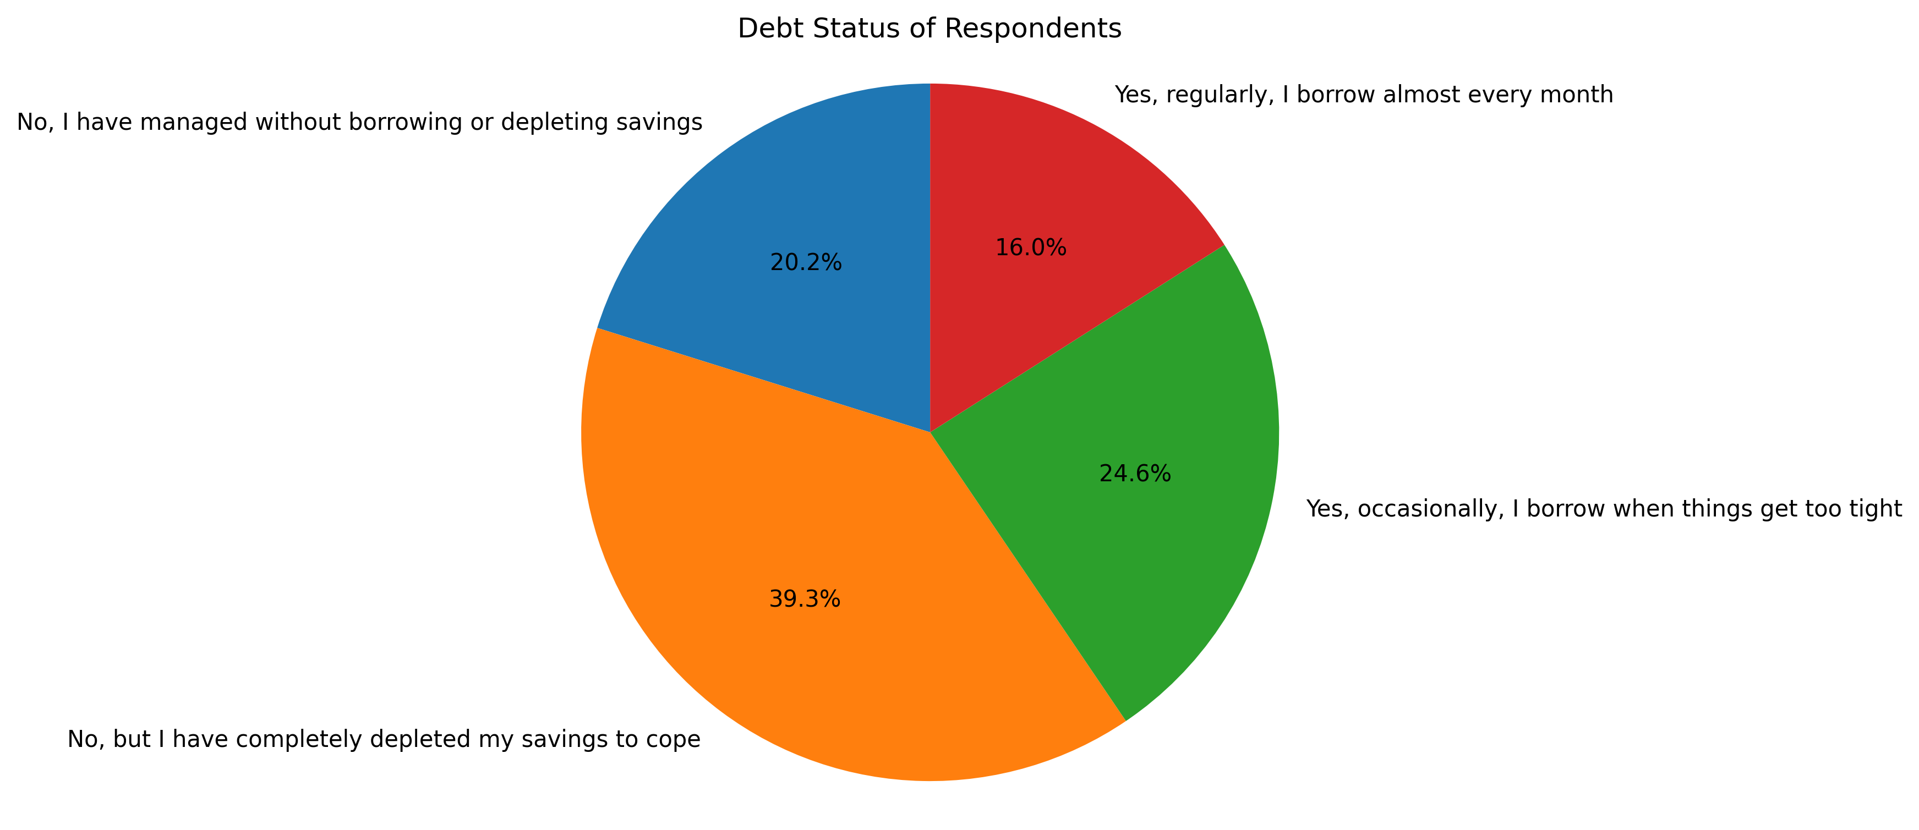
03 FINDINGS
Salary Adequacy and Debt Status
KEY TREND INSIGHTS:
Salary adequacy has declined for most respondents, with only 18.4% reporting an improvement in their financial situation.59.7% indicated that their salaries no longer adequately meet their financial needs.79.8% relied on borrowing or depleted savings to cope with rising living costs. The findings demonstrate that inflation has significantly weakened household financial resilience.
7

Slide 9
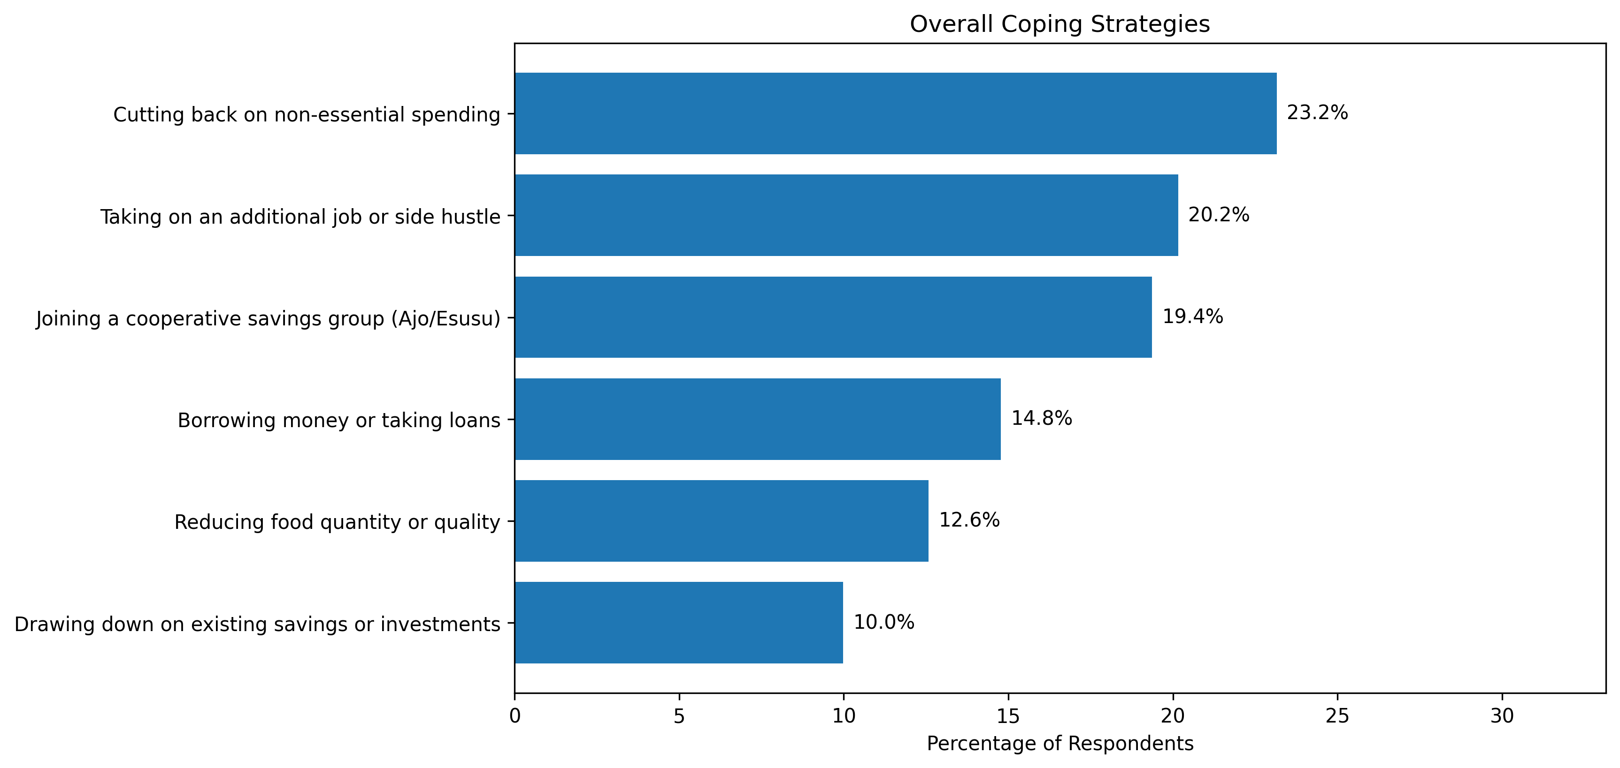
03 FINDINGS
Expenditure Category and Coping Strategy
INSIGHTS
Food & Groceries recorded the highest inflation impact score (3.80/5), making it the expenditure category most affected by rising prices.
Cutting back on non-essential spending recorded the highest coping strategy (23.2%)
8

Slide 10
03 FINDINGS
Analysis: 10 Queries, Key Discoveries
Most Affected Expenditure Category
Stopped or Reduced Savings
Depleted Savings
Food & Groceries recorded the highest inflation impact score (3.80/5), making it the expenditure category most severely affected by inflation.
57.28% of respondents reported reducing or completely stopping their savings due to rising living costs.
39.32% of respondents indicated that their savings had been completely depleted as a result of inflation.
Improved Rate among Gender
Most Affected among Gender
Most Struggling Rate among Gender
18.70% of male respondents reported an improvement in their financial situation, representing the highest improvement rate by gender.
Male respondents recorded the highest purchasing power impact, with 33.59% reporting significant financial pressure.
Female respondents recorded the highest financial struggle rate, with 24.29% experiencing severe financial difficulties.
Most Financially stable income group
Dominant Strategy among Low-income Earners
Dominant Strategy among Highest Earners
Respondents earning above ₦500,000 were the most financially stable, with 56.52% reporting better financial resilience.
Borrowing money or taking loans was the dominant coping strategy among respondents earning below ₦50,000, accounting for 49.15%.
Joining cooperative savings groups was the dominant coping strategy among respondents earning above ₦500,000, representing 47.83%.
9

Slide 11
04 PYTHON ANALYSIS
Statistical Analysis: Core Findings
PEARSON CORRELATION
Purchasing Power Decline Rate
49.7%
r = 0.6454
Respondents Spending 70%+ on Essentials
70.86%
Savings Crisis Rate
57.28%
Salary Adequacy vs Savings Behaviour
MODERATE POSITIVE
Debt Rate Among Respondents
40.5%
p-value = 2.27 × 10⁻⁶⁰
Statistically Significant: YES
Confidence Level: 95%
Most Affected Expenditure Category
Food & Groceries (3.8/5)
Most Financially Distressed Income Group
Below ₦50,000 (54.24% struggling)
Salary earners with better salary adequacy tend to maintain stronger savings behaviour
Most Resilient Income Group
Above ₦500,000 (56.52% improved)
10

Slide 12
05 POWER BI DASHBOARD
Interactive Dashboard
Built with an Inflation-themed colour palette
Page 1
Overview
Page 2
Purchasing Power Analysis
KPI cards, respondent demographics, purchasing power indicators, savings indicators, expenditure distribution, and dashboard summary.
Salary adequacy, purchasing power decline, income expenditure, debt rate, financial pressure, and key purchasing power insights.
Page 3
Expenditure Impact Analysis
Page 4
Savings Behaviour Analysis
Impact scores for food, transportation, healthcare, expenditure categories, income group analysis, and employment sector comparison.
Savings capacity, financial planning behaviour, emergency savings, inflation impact on savings, and long-term financial resilience.
Page 5
Demographic Impact Analysis
Page 6
Coping Strategies & Recommendations
Gender, income level, age group, and employment sector comparisons highlighting differences in purchasing power and savings behaviour.
Financial coping strategies, key findings, practical recommendations, and policy insights for improving purchasing power and rebuilding savings.
11

Slide 13
06 KEY FINDINGS
Key Findings from the Analysis
PURCHASING POWER HAS DECLINED SIGNIFICANTLY
Food, Transportation And Healthcare Are The Most Affected Expenditure Categories
Nearly half of the respondents (49.7%) reported a decline in purchasing power, while 70% spend more than 70% of their monthly income on essential needs, indicating that inflation has substantially reduced financial stability.
Food & Groceries recorded the highest inflation impact score, followed by Transportation & Fuel and Healthcare, making them the largest contributors to household financial pressure.
Savings Capacity Has Reduced Considerably
Lower-income Earners Experienced The Greatest Financial Impact
Only 16.4% of respondents reported saving more than before, while many indicated reduced savings or complete inability to save due to rising living costs.
Respondents earning below ₦150,000 recorded the highest purchasing power impact, while differences were also observed across gender, age groups and employment sectors.
Public Sector Workers Experienced The Highest Purchasing Power Impact
Nigerian Salary Earners Are Adopting Multiple Coping Strategies
Among employment sectors, public sector employees recorded the highest average purchasing power impact score, indicating greater financial pressure compared with other sectors.
Respondents are adjusting spending habits, prioritizing essential expenses, reducing savings and adopting other financial coping strategies to manage the effects of inflation.
12

Slide 14
07 LIMITATIONS
Project Limitations & Future Research
STUDY LIMITATIONS
FUTURE RESEARCH DIRECTIONS
Convenience Sampling This may have excluded salary earners in remote or rural areas with limited internet access, potentially introducing a selection bias toward more urban and digitally connected respondents. Self-Reported Data There is a possibility that some respondents may not have accurately disclosed their true income levels, savings habits, or debt situations due to social desirability bias, the tendency to present oneself more favourably than reality Exclusion of Informal Salary Earners The screening question requiring a minimum of three years of salary-earning experience, while methodologically sound, excluded newer entrants to the workforce, including recent graduates and those who recently transitioned from informal to formal employment. These groups may have different and equally important experiences of inflation's impact on their early-career financial development.
A longitudinal study tracking the same cohort of Nigerian salary earners over three to five years to measure how purchasing power and savings behaviour change as inflation fluctuates over time.
A qualitative study using in-depth interviews with salary earners in the below ₦50,000 income bracket to gain deeper insight into the lived experience of financial distress caused by inflation, going beyond what questionnaire data can capture.
A comparative study examining the differential impact of inflation on salary earners across Nigeria's six geopolitical zones, using stratified random sampling to ensure equal representation of all regions.
A study specifically examining the impact of inflation on the retirement savings and long-term financial planning of Nigerian salary earners, as this study found significant savings collapse, but did not specifically measure retirement preparedness.
An evaluation study measuring the actual effectiveness of cooperative savings groups as a financial resilience tool for low-income salary earners in Nigeria.
14

Slide 15
08 SUMMARY
Summary
This study confirms that inflation has created a real, widespread, and deepening financial crisis for Nigerian salary earners. Nearly half of all respondents, 49.7%, can no longer afford what their salary comfortably covered two to three years ago, and over 70% are spending more than 70% of their entire monthly income on essential needs alone, leaving virtually nothing for savings or emergencies.
Food and Groceries emerged as the single most devastating expenditure category, confirming that the most fundamental human need, eating, has become one of the greatest financial burdens for Nigeria’s working population. The savings crisis is equally alarming, with 58.08% of respondents either stopping or significantly reducing savings, and only 1 in 5 respondents is genuinely financially stable.
WHAT THE DATA TELLS US
Inflation has significantly weakened the purchasing power of Nigerian salary earners, making it increasingly difficult for many households to meet essential financial needs.
Food & Groceries, Transportation & Fuel, and Healthcare have become the greatest sources of financial pressure, consuming a larger share of household income.
The decline in savings capacity and the increasing reliance on financial coping strategies indicate that many salary earners are struggling to maintain long-term financial security.
Lower-income earners experienced the greatest financial impact, highlighting the need for targeted economic policies and income-support measures for vulnerable households.
14

Slide 16
09 CONCLUSION
Conclusion
WHAT THIS PROJECT CONCLUDES
This study confirms that inflation has created a real, widespread, and deepening financial crisis for Nigerian salary earners. Nearly half of all respondents, 49.7%, can no longer afford what their salary comfortably covered two to three years ago, and over 70% are spending more than 70% of their entire monthly income on essential needs alone, leaving virtually nothing for savings or emergencies.
SIGNIFICANCE OF THE FINDINGS
Lower-income salary earners are not just earning less; they are also coping less effectively.
The poorest salary earners borrow money to survive, while the most financially stable earners join cooperative savings groups to build wealth.
This compounding disadvantage confirms that addressing Nigeria's inflation crisis requires simultaneous action from government, employers, financial institutions, and individuals, moving away from reactive debt-driven survival toward proactive income diversification, cooperative savings, and financial planning.
15

Slide 17
10 RECOMMENDATIONS
Recommendations
Evidence-based actions for governments, employers, financial institutions, and all salary earners
Federal Government: Annual Minimum Wage Review Tied to CPI
Government: Targeted Food Price Stabilization Measures
The federal government must establish a formal mechanism for automatically reviewing the national minimum wage annually in line with the Consumer Price Index, similar to systems used in the United Kingdom and South Africa. This would ensure that salary earners do not silently lose purchasing power between formal wage negotiations.
Investment in food storage infrastructure across all six geopolitical zones would reduce post-harvest losses and stabilise prices year-round. Repair of rural feeder roads connecting farming communities to urban markets would directly reduce transportation costs currently being passed on to consumers.
All Salary Earners: Embrace Cooperative Savings Groups
Employers: Cost of Living Allowances
Employers should facilitate this by creating formal workplace savings cooperatives, allowing members to make regular contributions directly from their salary and access emergency loans at low or zero interest rates from the collective pool.
Private sector employers and government institutions should introduce Cost of Living Allowances specifically designed to bridge the gap between current salary levels and actual living costs. Subsidised meal programmes, transportation allowances, and medical allowances would directly address the three expenditure categories confirmed as most severely impacted.
Government: Expand Social Protection Programmes
Employers and Government: Workplace Financial Literacy Programmes
The government's existing social protection programmes, including the Conditional Cash Transfer scheme and the National Social Investment Programme, must be significantly expanded to reach not just the unemployed poor but also the working poor, salary earners whose income has been so severely reduced by inflation.
Employers, financial institutions, and government agencies should collaborate to deliver regular, practical, and accessible financial literacy programmes in workplaces that cover budgeting, debt management, cooperative savings, and income diversification.
16

Slide 18
THANK YOU
Analysis of Inflation on the purchasing power and savings Behaviour of Nigerian Salary Earners
"Every salary earner deserves more than sympathy. They deserve answers. And they deserve solutions."
Questions and Answers

